Slide 1






FRUIT QUALITY DETECTION USING SWIN TRANSFORMER
An AI-powered fruit quality detection system that classifies fruits as fresh or stale.
Users upload images, and the AI model analyzes fruit quality.
Helps businesses reduce waste, optimize inventory, and improve distribution efficiently.
Cold storage
Food processing industries
Supermarkets and grocery stores
Farmers and fruit suppliers

Slide 2




Manual Process
Inefficient & Delays
Food Waste 🗑️
Business Loss
AI System
Automated & Real-time ⚡
Less Waste
Higher Profits
USER
Storage Managers Suppliers
Farmers
Costumers
Dataset:
https://www.kaggle.com/datasets/raghavrpotdar/fresh-and-stale-images-of-fruits-and-vegetables & Custom Dataset
ADMIN
AI MODEL
Data Source:
Supermarkets
Local Fruit Vendors
Direct from Trees

Slide 3
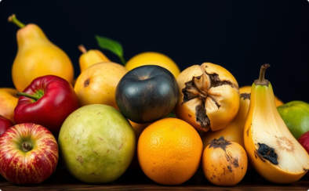






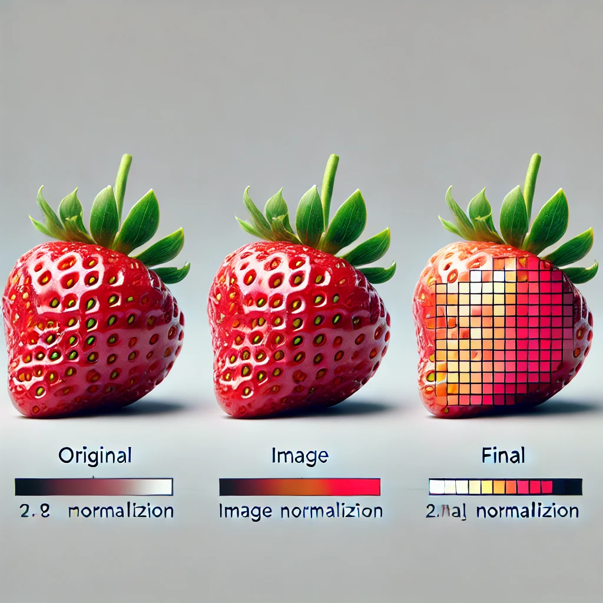
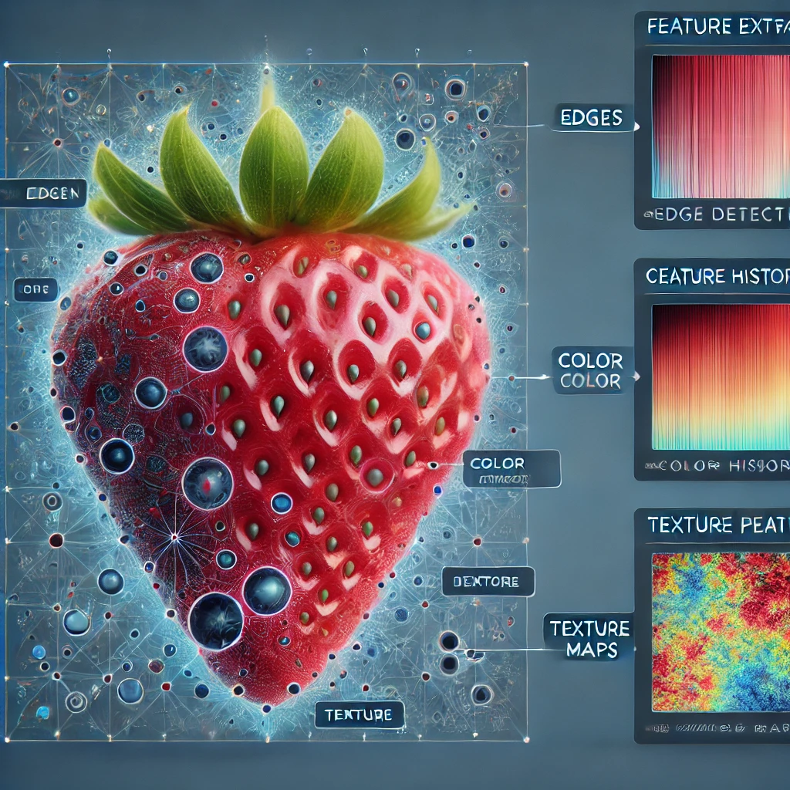
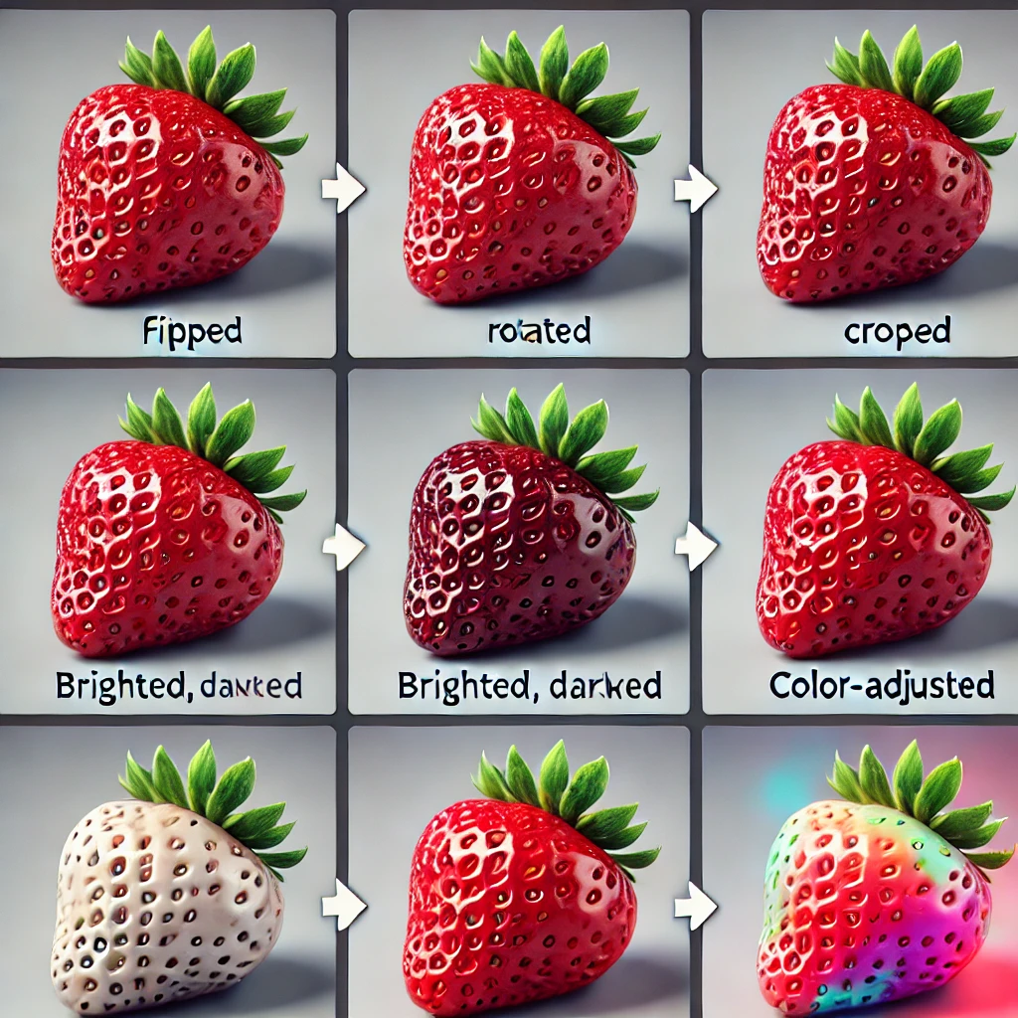
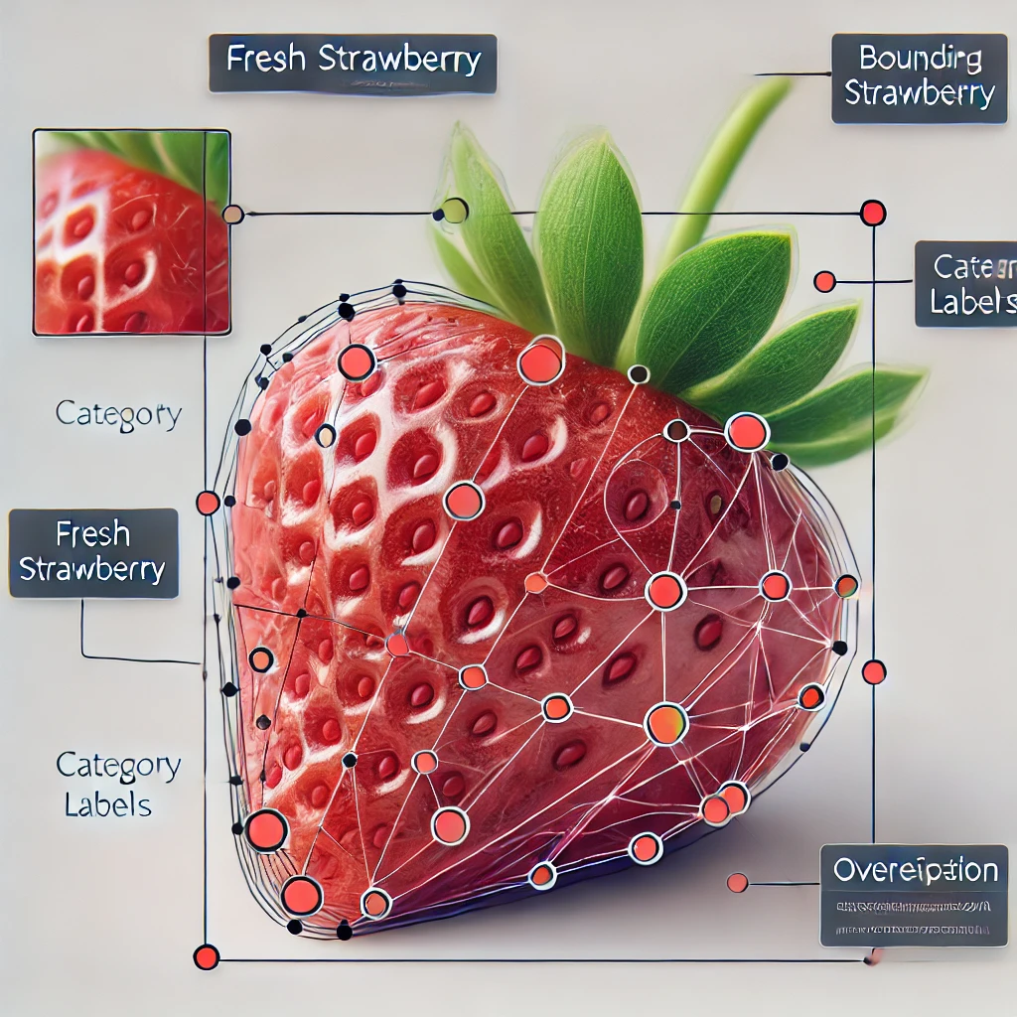
Data Acquisition
Image Preprocessing
Model Training
Evaluation
INPUT
Resizing
Normalizing
Feature extraction
OUTPUT
Augmentation
Labeling
TECHSTACK-
FRONTEND: React.js
BACKEND: Express.js
AI MODEL: Swin transformer and CNN
DATABASE: MongoDB
CLOUD DEPLOYMENT: AWS/GCP

Slide 4
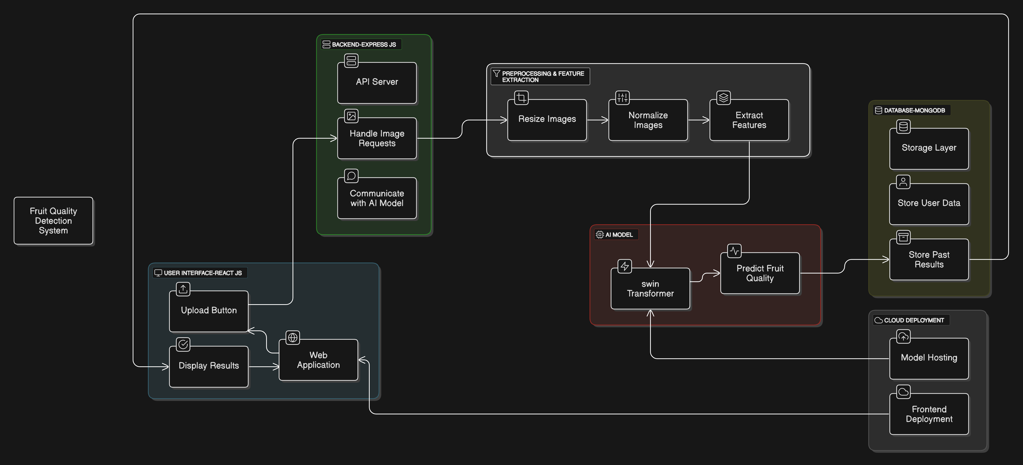
Architecture diagram of stale fruit detection

